Slide 1
Gaining insight from PDFs using Intelligence Suite
Chris Goodman - PwC

Slide 2
Session Outline
Do you have an idea for an analytic project but the data is stuck in a PDF document?
In this session we will show you business applications of extracting information from a variety of PDF documents (invoices, financial statements, text documents) and use this in combination with text mining tools in Intelligence Suite to extract information for use in your analytic process.

Slide 3



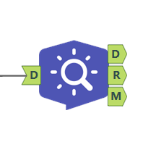
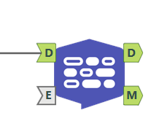
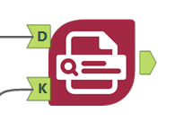

What are the Intelligence Suite tools we will be covering
Image Input
Image Template
Image to Text
Key Value Pair Extraction
Topic Modelling
Named Entity Recognition

Slide 4
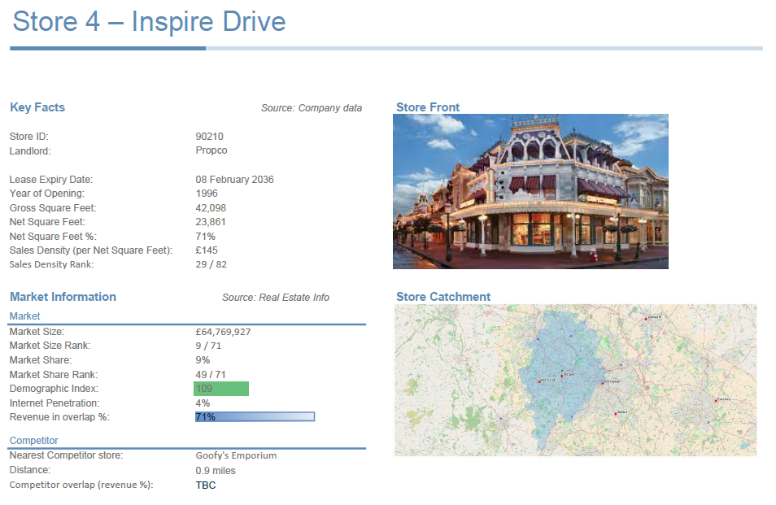
Processing PDFs using Annotation
Example document is a summary information about real estate properties, with multiple pages with the same information on each page

Slide 5
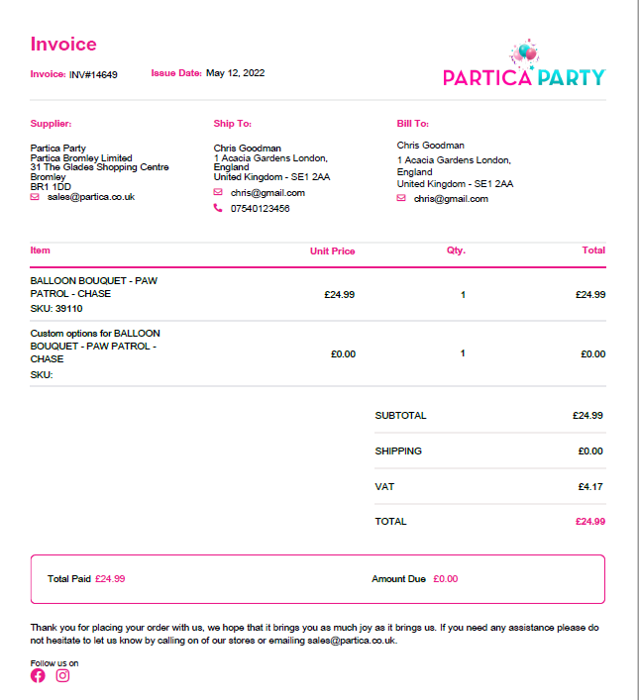
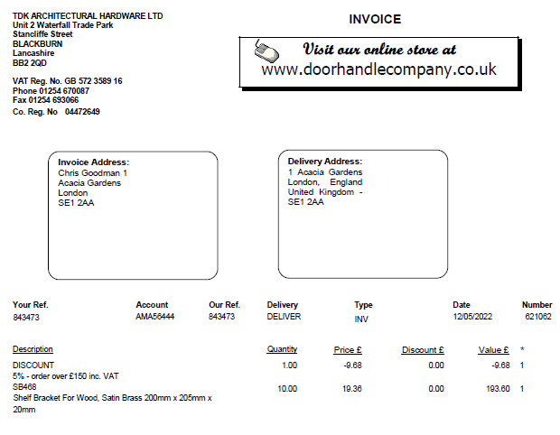
Extracting information from invoices using KVP
Key Value Pair is a new tool added to the laboratory tool category as part of 2022.1
Annotation is great when data is in a consistent location in each document, but what happens when the information you want is in multiple locations, e.g. multiple supplier invoices

Slide 6
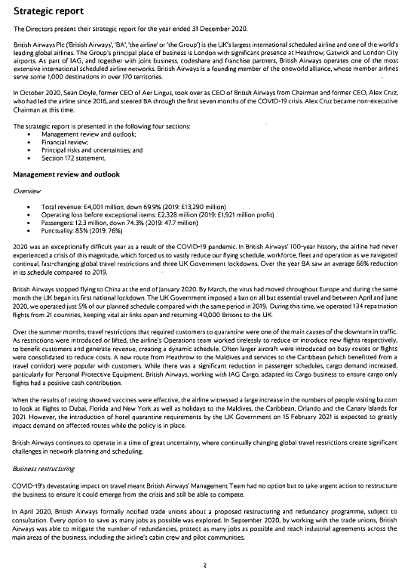
Extracting Text and using topic modelling
Financial reports contain lots of text information, such as the strategic report.
How to you gain insight from the FTSE 350 about trends
Topic modelling can help work through and classify these documents
More powerful than just keyword searches for classification, as do you have the full dictionary of search terms, for example – covid, covid-19, coronavirus, pandemic

Slide 7
Thank You

